Slide 1

CSCI 476: Computer Security
Lecture 5: Set-UID and Environment Variables
Reese Pearsall
Fall 2023
*all images are stolen from the internet
https://www.cs.montana.edu/pearsall/classes/fall2023/476/main.html

Slide 2
Announcements
Lab 0 due this Sunday September 10th
No class next Thursday (Reese will be gone)
→ Work on lab 1 instead
Lab 1 posted, due Sunday September 24th

Slide 3
How would you protect your computer and its resources?

Slide 4
Access Control
who can do what to whom?
users/groups
what is their identity?
Objects
Usually things on a filesystem
permissions (read/write/execute)
Ok, I know the who– what are you permitted to do?

Slide 5
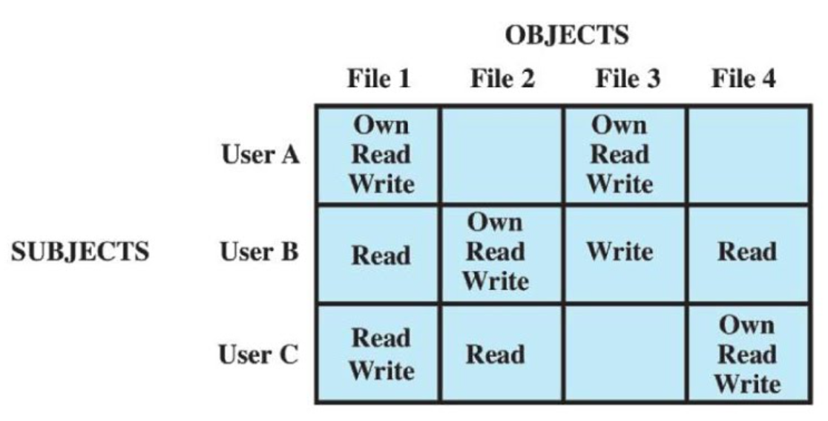
who can do what to whom?
Access Control
Access Control Matrix
What are some issues with this?

Slide 6
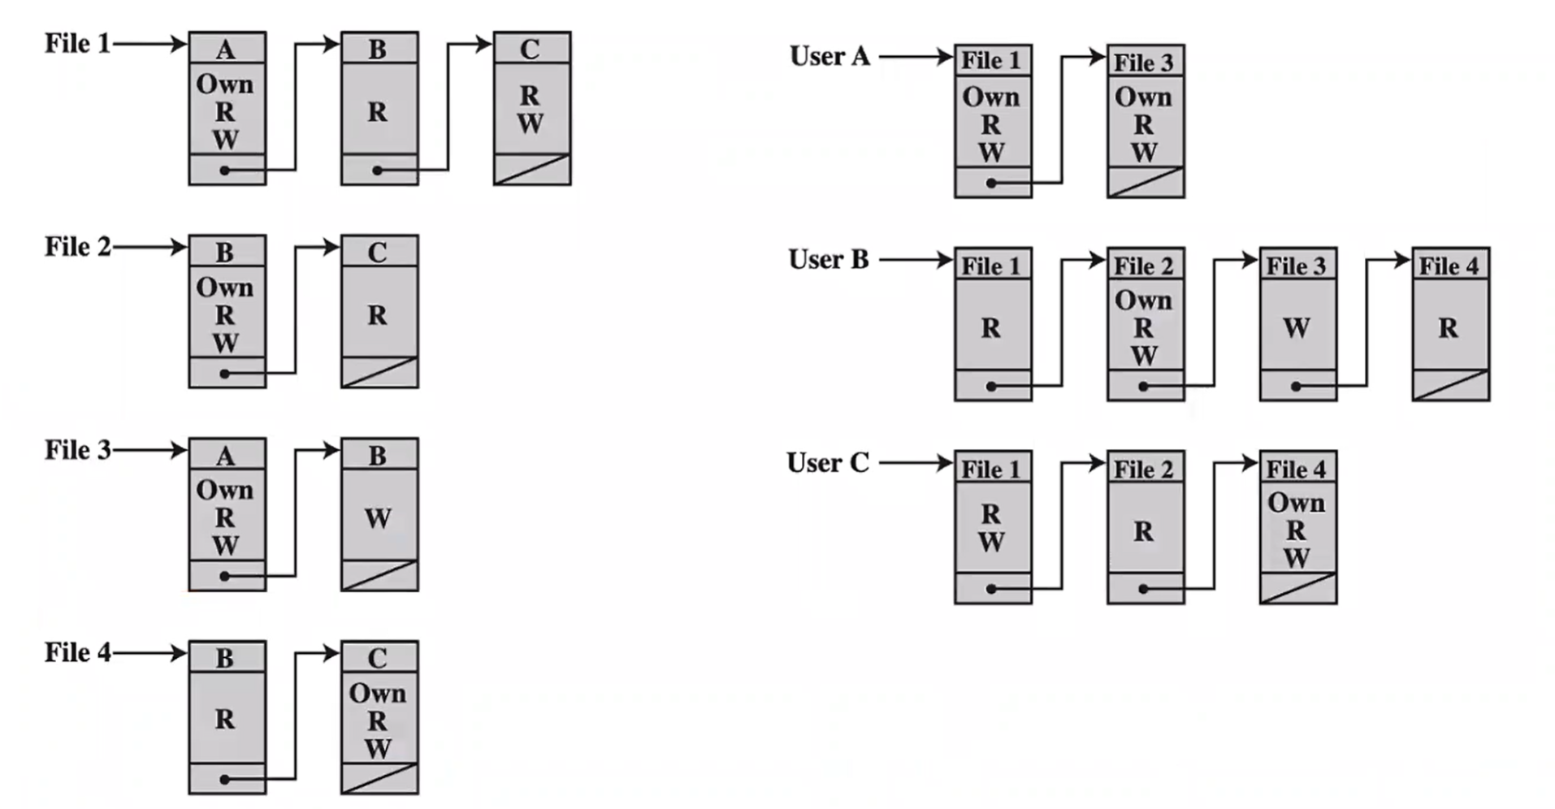
who can do what to whom?
Access Control
Wont take up as much memory!
Access Control list (ACL)

Slide 7
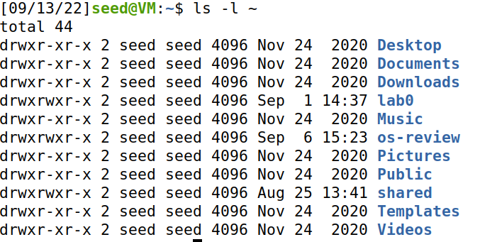
Unix File Modes and Permissions
Every Unix file has a set of permissions that determine whether someone can read, write, or run the file
ls –l ~
ls –l /dev

Slide 8
Unix File Modes and Permissions
Every Unix file has a set of permissions that determine whether someone can read, write, or run the file
ls –l ~
ls –l /dev
Permissions for the file

Slide 9
Unix File Modes and Permissions
Every Unix file has a set of permissions that determine whether someone can read, write, or run the file
Owner/group information
ls –l ~
ls –l /dev
Permissions for the file

Slide 10
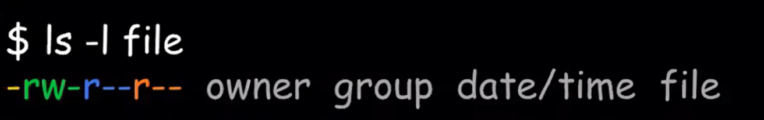
Unix File Modes and Permissions
Every Unix file has a set of permissions that determine whether someone can read, write, or run the file
File permissions (4 parts)
[file type][user][group][other]

Slide 11
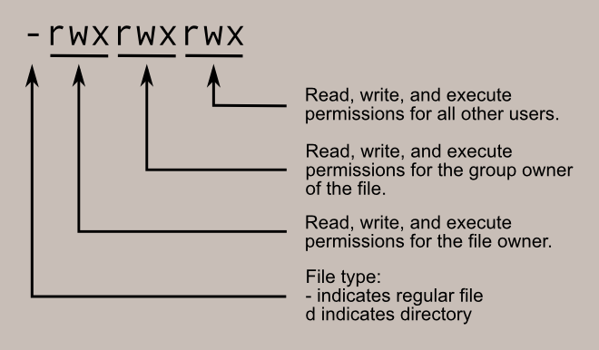
Unix File Modes and Permissions
File permissions (4 parts)
[file type][user][group][other]

Slide 12
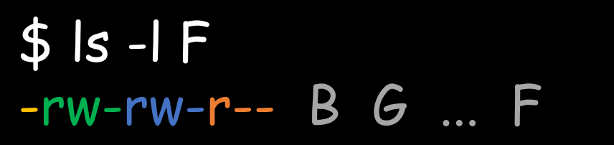
Unix File Modes and Permissions
[file type][user][group][other]
Suppose you have the following file:
If user A asks to perform some operation O on a file object F, the OS checks:
Is A the owner of F?

Slide 13

Unix File Modes and Permissions
[file type][user][group][other]
Suppose you have the following file:
If user A asks to perform some operation O on a file object F, the OS checks:
Is A the owner of F?
No, B is the owner

Slide 14
Unix File Modes and Permissions
[file type][user][group][other]
Suppose you have the following file:
If user A asks to perform some operation O on a file object F, the OS checks:
Is A the owner of F?
Is A a member of F’s group?

Slide 15

Unix File Modes and Permissions
[file type][user][group][other]
Suppose you have the following file:
If user A asks to perform some operation O on a file object F, the OS checks:
Is A the owner of F?
Is A a member of F’s group?
Suppose G = {B,C,F}
A is not in F’s group

Slide 16
Unix File Modes and Permissions
[file type][user][group][other]
Suppose you have the following file:
If user A asks to perform some operation O on a file object F, the OS checks:
Is A the owner of F?
Is A a member of F’s group?
Otherwise, what can they do?

Slide 17

Unix File Modes and Permissions
[file type][user][group][other]
Suppose you have the following file:
If user A asks to perform some operation O on a file object F, the OS checks:
Is A the owner of F?
Is A a member of F’s group?
Otherwise, what can they do?
Everyone can read file F

Slide 18
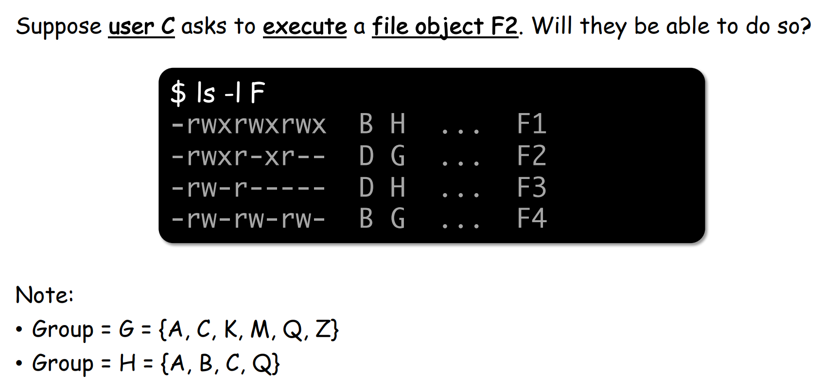
Unix File Modes and Permissions
[file type][user][group][other]

Slide 19


Unix File Modes and Permissions
[file type][user][group][other]

Slide 20
Limitations of File-Based Access Control
When would a non-privilege user require more power/permissions?

Slide 21
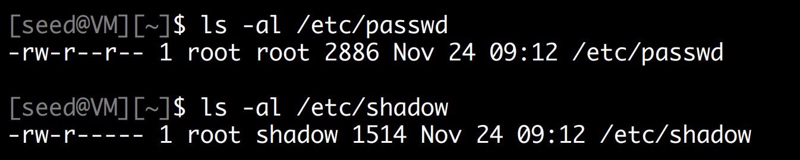
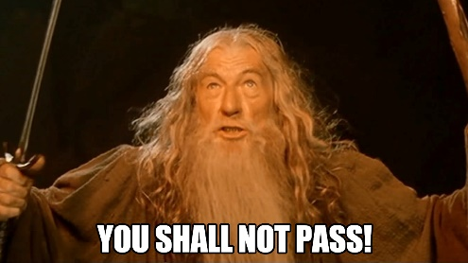
Limitations of File-Based Access Control
When would a non-privilege user require more power/permissions?
Changing password!

Slide 22
Limitations of File-Based Access Control
When would a non-privilege user require more power/permissions?
Changing password!
/etc/passwd and /etc/shadow hold encrypted passwords for the user, in order to change our password, we will need to have access to those directories

Slide 23
Limitations of File-Based Access Control
When would a non-privilege user require more power/permissions?
Changing password!
/etc/passwd and /etc/shadow hold encrypted passwords for the user, in order to change our password, we will need to have access to those directories
root (aka admin) is the only person that has write permissions!

Slide 24
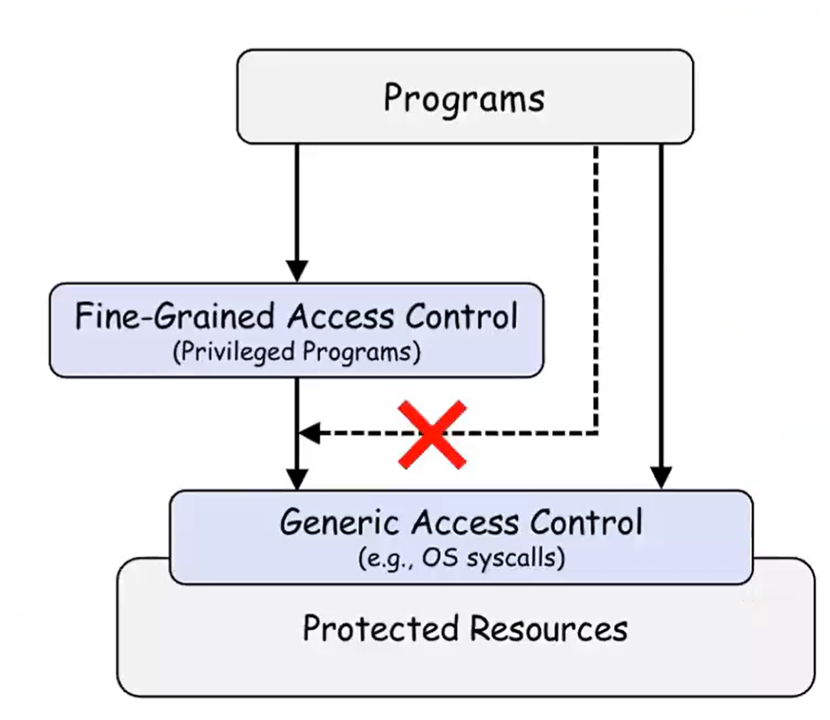

Limitations of File-Based Access Control
Instead of having a user deal with sensitive actions, lets have a privileged program do it for us!

Slide 25
Types of Privileged Programs
Daemons
Computer program that runs in the background
Needs to run as root or other privileged users
Set-UID Programs
Widely used in UNIX systems
A normal program… but marked with a special bit

Slide 26

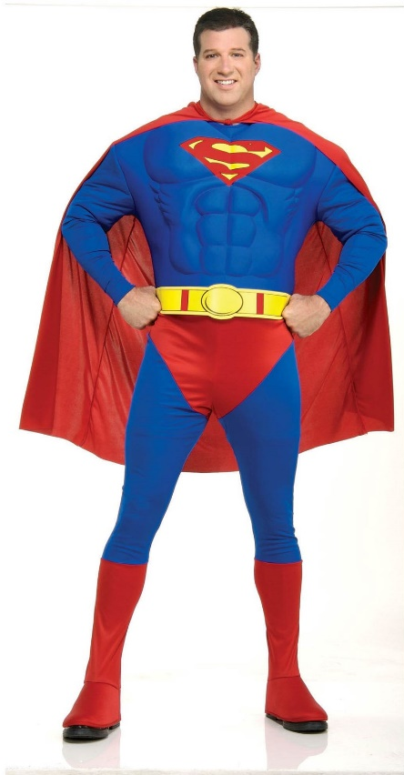
The superman story
Superman got tired of saving the city every day
So, he decided to create a “super suit” that would give normal people his powers
Problem: Not all super people are good………

Slide 27
The superman story
Superman got tired of saving the city every day
So, he decided to create a “super suit” that would give normal people his powers
Problem: Not all super people are good………
Super suit 2.0
Super suit with a dope computer
Programmed to perform a specific task
No way to deviate from the pre-programmed task

Slide 28
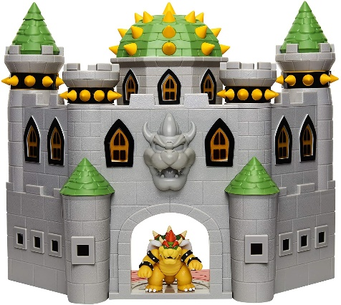


The superman story
Task: Stop Bowser
Fly North
Turn left and move forward
Punch
Super suit 2.0
People can hop in, and do the specific task to stop bowser

Slide 29
The superman story
Task: Stop Bowser
Fly North
Turn left and move forward
Punch

Slide 30
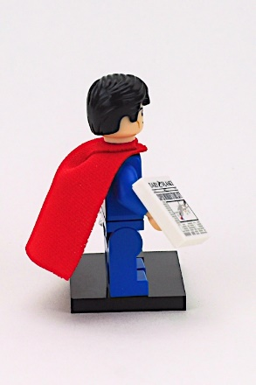
The superman story
Task: Stop Bowser
Fly North
Turn left and move forward
Punch

Slide 31
The superman story
Task: Stop Bowser
Fly North
Turn left and move forward
Punch

Slide 32
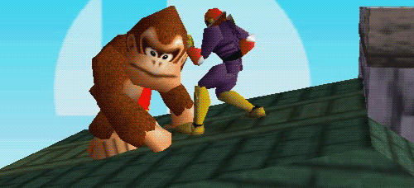
The superman story
Task: Stop Bowser
Fly North
Turn left and move forward
Punch

Slide 33
The superman story
Task: Stop Bowser
Fly North
Turn left and move forward
Punch
This works great! People can only do the predetermined task and don’t have control!

Slide 34
The superman story
Task: Stop Bowser
Fly North
Turn left and move forward
Punch
This works great! People can only do the predetermined task and don’t have control!
Exploitable?

Slide 35

The superman story
Task: Stop Bowser
Fly North
Turn left and move forward
Punch
Suppose I come along, and I see the power suit
And I decide to flip the suit around
Now what happens???

Slide 36
The superman story
Task: Stop Bowser
Fly North
Turn left and move forward
Punch
Suppose I come along, and I see the power suit
And I decide to flip the suit around
Now what happens???

Slide 37
The superman story
Task: Stop Bowser
Fly North
Turn left and move forward
Punch
Suppose I come along, and I see the power suit
And I decide to flip the suit around
Now what happens???

Slide 38
The superman story
Task: Stop Bowser
Fly North
Turn left and move forward
Punch
Suppose I come along, and I see the power suit
And I decide to flip the suit around
Now what happens???

Slide 39
The superman story
Task: Stop Bowser
Fly North
Turn left and move forward
Punch
Suppose I come along, and I see the power suit
And I decide to flip the suit around
Now what happens???

Slide 40

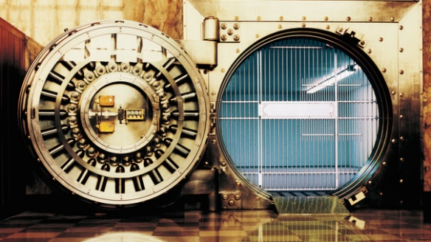
The superman story
Task: Stop Bowser
Fly North
Turn left and move forward
Punch
Suppose I come along, and I see the power suit
And I decide to flip the suit around
I still followed the steps, but now we have a totally different outcome
My plan was to rob the bank, and I had friends waiting this whole time!

Slide 41
Set-UID In a Nutshell
Set-UID allows a user to run a program with the program owner’s privilege
User runs a program w/ temporarily elevated privileges
Created to deal with inflexibilities of UNIX access control
Example: The passwd program

Slide 42

Set-UID In a Nutshell
Set-UID allows a user to run a program with the program owner’s privilege
User runs a program w/ temporarily elevated privileges
Every process has two User IDs
Real UID (RUID)– Identifies the owner of the process
Effective UID (EUID)– Identifies current privilege of the process
When a normal program is executed
RUID == EUID
If a program owner == root,
The program runs with root privileges
When a Set-UID program is executed
RUID != EUID
EUID == ID of the program’s owner

Slide 43
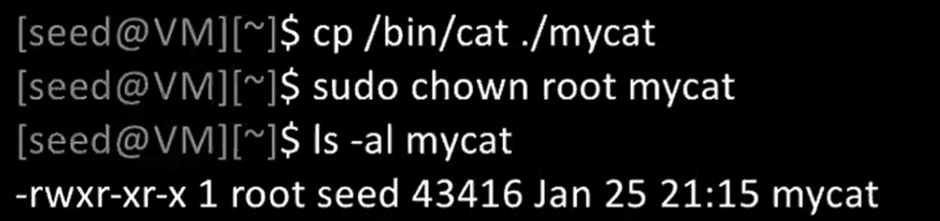
Set-UID Program Demo
Change the owner of a file to root

Slide 44
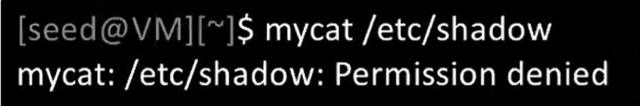
Set-UID Program Demo
Change the owner of a file to root
Running to program (normally)

Slide 45
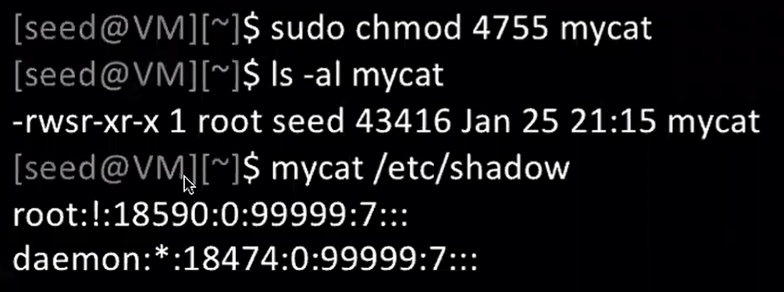

Set-UID Program Demo
Change the owner of a file to root
Running to program (normally)
Enable the Set-UID bit
We have successfully made a Set-UID program!

Slide 46
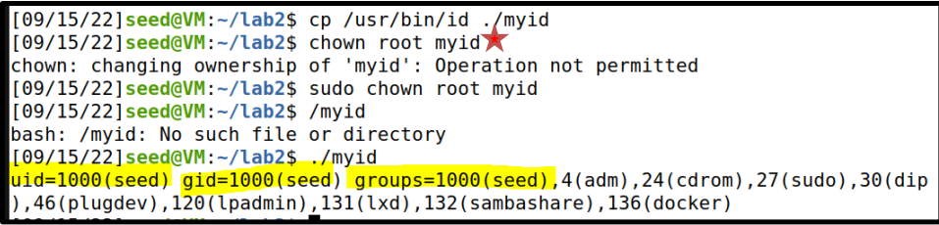
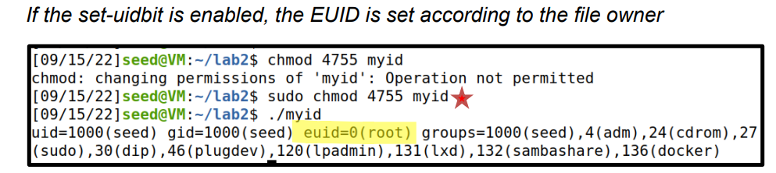
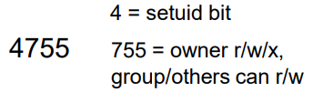
A Set-UID program is just like any other program, except that is has a special bit set
Steps for creating a set-uid program
Change file ownership to root (chown)
2. Enable to Set-uid bit (chmod)
Access control decisions made based on EUID, not RUID !

Slide 47
So…. Is Set-UID secure?
Allows normal users to escalate privileges
➢ This is different from directly giving escalated privileges (such as sudo)
➢ Restricted behavior (think power suit 2.0)
Are there any programs that should not be Set-UID programs?

Slide 48
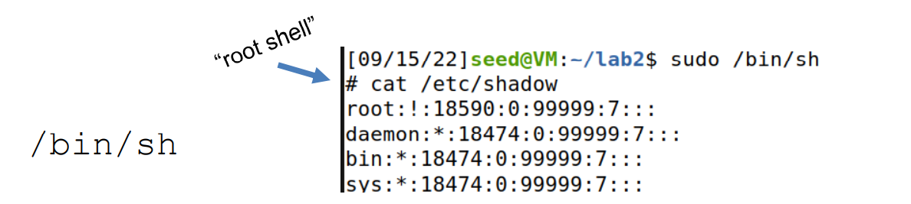
So…. Is Set-UID secure?
Allows normal users to escalate privileges
➢ This is different from directly giving escalated privileges (such as sudo)
➢ Restricted behavior (think power suit 2.0)
Are there any programs that should not be Set-UID programs?

Slide 49
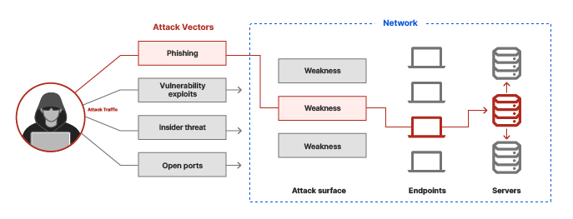
Attack Surface of (Set-UID) Programs
An attack surface is the aggregation of all exposed entry points/weaknesses into the system to gain unauthorized access

Slide 50
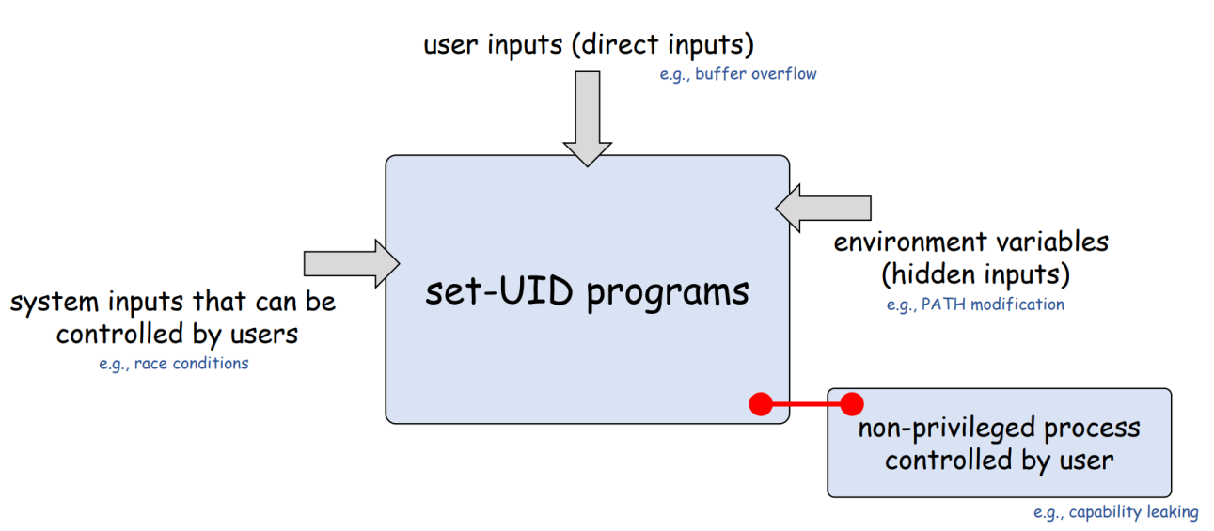
Attack Surface of (Set-UID) Programs
An attack surface is the aggregation of all exposed entry points/weaknesses into the system to gain unauthorized access

Slide 51

Attack Surface of (Set-UID) Programs
An attack surface is the aggregation of all exposed entry points/weaknesses into the system to gain unauthorized access

Slide 52

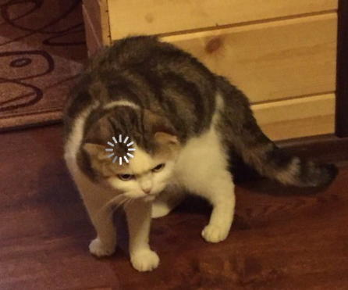

Invoking Programs from within programs

Slide 53
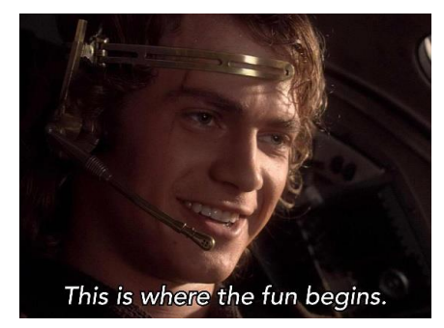
Before we get started….
We need to disable a countermeasure on our OS, and set our shell (/bin/sh) to be an unsafe version
/bin/sh is an alias for /bin/dash. /bin/dash has countermeasures for some of our attacks

Slide 54
Invoking a program with a program
We can invoke external commands/programs from INSIDE another program
system()
exec()-family

Slide 55
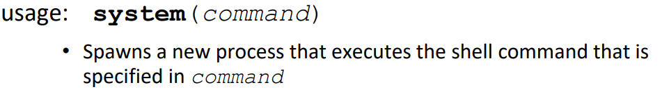
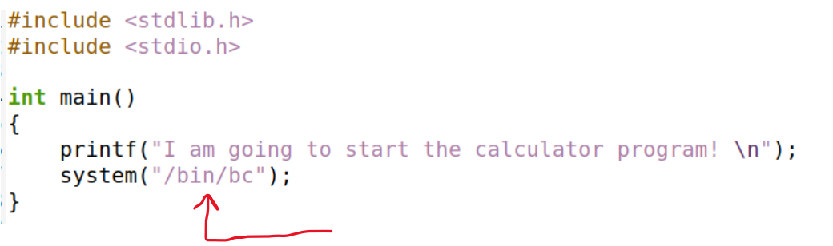
System()

Slide 56
audit Set UID program
Suppose you are preparing for an audit. An auditor may need the access to view certain files.
Instead of giving them total access to everything on the system, we will create a privileged program that will the auditor view the content of some file
Set-UID program name
Name of file the auditor will view
./audit company_data.csv
./audit ../lab0/solution.docx

Slide 57
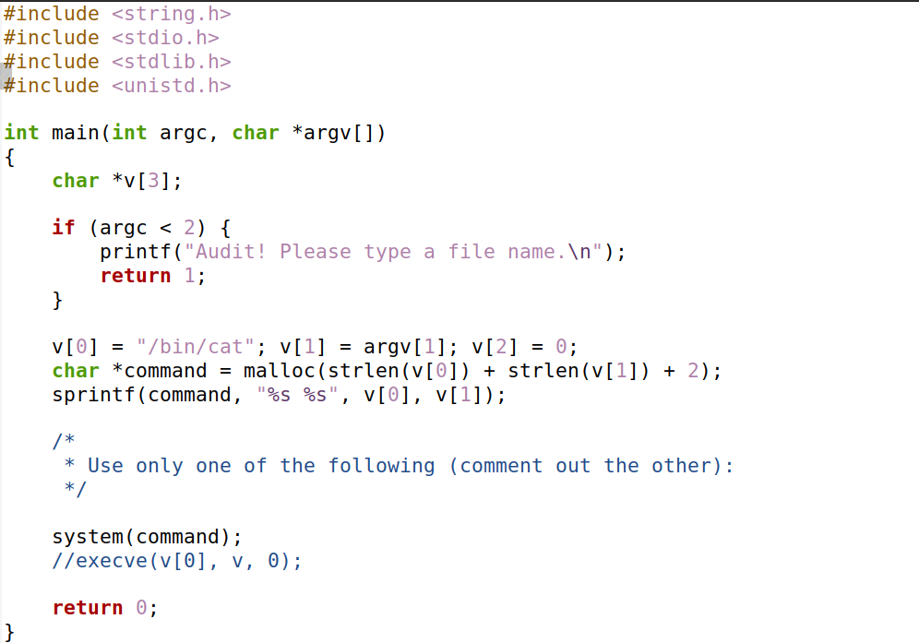
catall.c
The command line argument (file path) is appended to the string “/bin/cat”
Spawns a new process that executes:
/bin/cat [FILE_PATH]
ex. /bin/cat my_file.txt

Slide 58
Suppose you are preparing for an audit. An auditor may need the access to view certain files.
Instead of giving them total access to everything on the system, we will create a privileged program that will the auditor view the content of some file
Set-UID program name
Name of file the auditor will view
./audit company_data.csv
./audit ../lab0/solution.docx
/bin/cat company_data.csv
/bin/cat ../lab0/solution.docx

Slide 59
Suppose you are preparing for an audit. An auditor may need the access to view certain files.
Instead of giving them total access to everything on the system, we will create a privileged program that will the auditor view the content of some file
Set-UID program name
Name of file the auditor will view
./audit company_data.csv
./audit ../lab0/solution.docx
/bin/cat company_data.csv
/bin/cat ../lab0/solution.docx
!!! We have some control over the behavior of this program

Slide 60
!!! We have some control over the behavior of this program
Program Input:
./audit company_data.csv
Command Executed
/bin/cat company_data.csv
Because this is a SET-UID program, things can get very interesting

Slide 61
system() is a very unsafe function
We can exploit this by maliciously constructing the input to this program
Hint: the string passed to system() can include multiple commands

Slide 62
system() is a very unsafe function
We can exploit this by maliciously constructing the input to this program
Hint: the string passed to system() can include multiple commands
./audit “my_info.txt; /bin/sh”

Slide 63
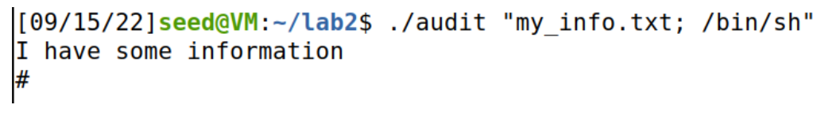
./audit “my_info.txt; /bin/sh”
system(/bin/cat my_info.txt; /bin/sh)
system() interprets this as two separate commands

Slide 64




./audit “my_info.txt; /bin/sh”
system(/bin/cat my_info.txt; /bin/sh)
system() interprets this as two separate commands

Slide 65
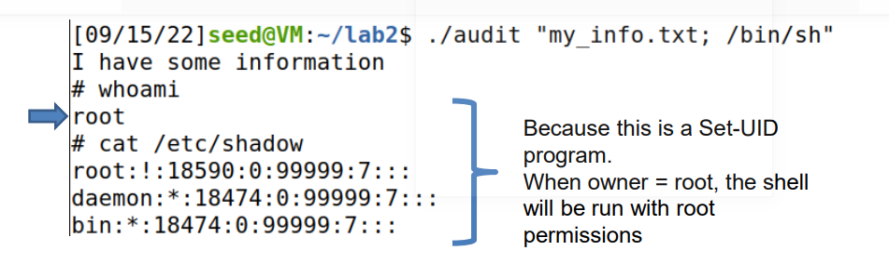



./audit “my_info.txt; /bin/sh”
system(/bin/cat my_info.txt; /bin/sh)

Slide 66


./audit “my_info.txt; /bin/sh”
system(/bin/cat my_info.txt; /bin/sh)
We have gained access into the system

